Slide 1
Bioinformatics Team© presents Machine Learning for Citation Prediction
Luke Davis Darpan Jhawar
Logan Hornbuckle
Mouna Kalidindi Charles Stamey
Notes:
Luke

Slide 2
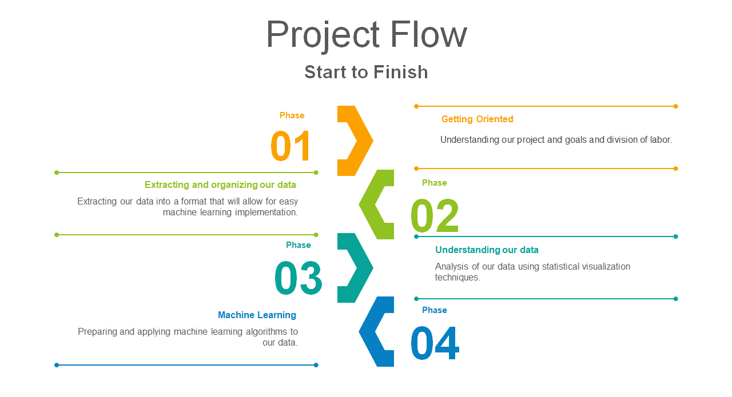
Notes:
Luke

Slide 3
Getting Orientated
Source of data
Originally pulled from SCOPUS
Consists of research papers listed as “Bioinformatics”
Started in json format
Notes:
Luke
scopus: database of peer-reviewed literature
about 85000 total

Slide 4
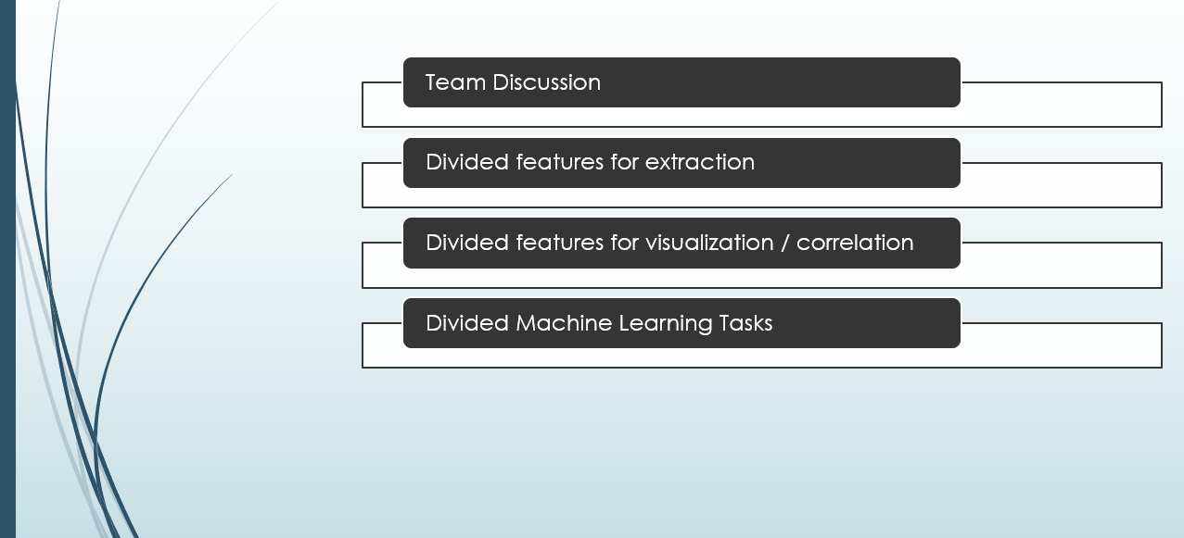
Division of Tasks
Notes:
Logan

Slide 5
Goals
Primary Goal: predicting citations
Secondary Goal: discover interesting trends/patterns
Notes:
Logan

Slide 6
Steps to achieve primary goal
Data familiarization
Organize and analyze
Prepare data for Machine Learning
Apply Machine Learning
Notes:
Logan

Slide 7

II. Data Extraction & Organization
Extracted data from json files into a Pandas dataframe
Converted this dataframe into a .csv file
This process was more challenging than expected
Nested dictionaries
Nested lists
Null fields
Notes:
Darpan

Slide 8
Extracted Features
Affiliation_id
Affiliation_name
Affiliation_country
Eid
Num_of_Citations
Language
First para
Title
Year
Publication_name
Publication_type
Author_Keyword
FOS_abbreviation
FOS_detailed
Author ID
Author Sequence
Author Indexed Name
Eid
Author ID
Affiliation ID
Notes:
Darpan

Slide 9
Feature Set after combining all files
Eid
Num_of_Citations
Language
First para
Title
Year
Publication_name
Publication_type
Author_Keyword
FOS_abbreviation
FOS_detailed
First_Author ID
First_Author Sequence
First_Author Indexed Name
Last_Author ID
Last_Author Sequence
Last_Author Indexed Name
First_Author_Affiliation_id
First_Author_Affiliation_name
First_Author_Affiliation_country
Last_Author_Affiliation_id
Last_Author_Affiliation_name
Last_Author_Affiliation_country
Num_Of_Authors
Notes:
Darpan

Slide 10
III. Understanding our data
We visualized the distribution of our target:
Citations
We analyzed how our features correlate and relate to citations
Results were mixed
Additionally, we found some interesting data relating to country affiliation
Notes:
Steve

Slide 11
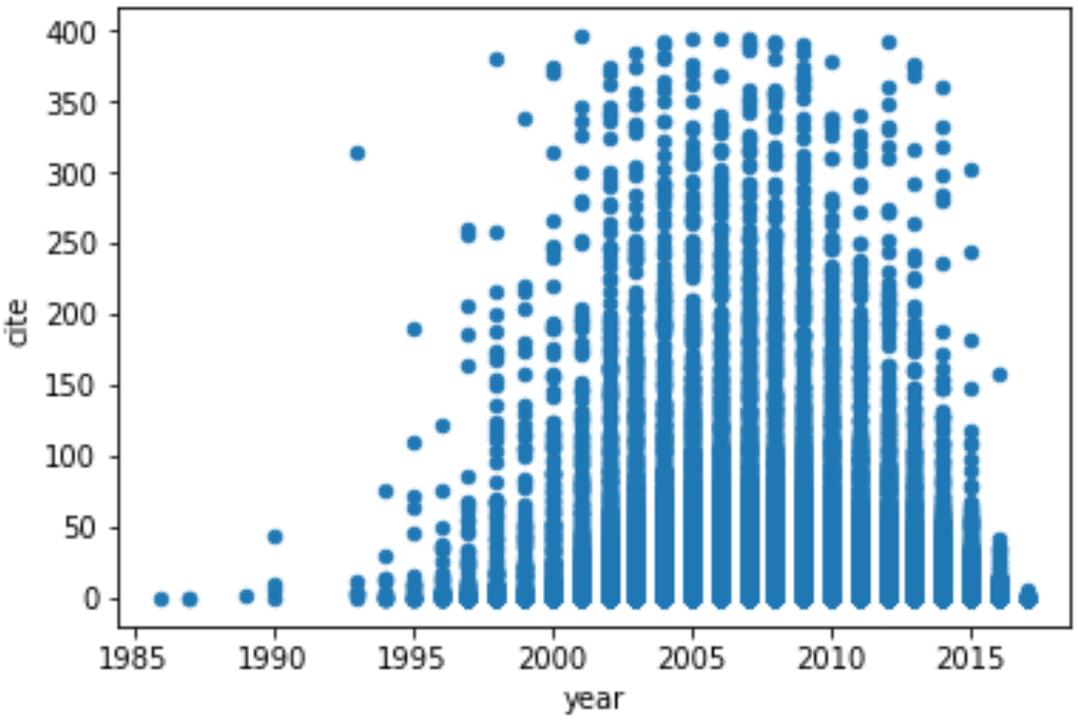
Citations
Understanding our target
Scatterplot of citations over time
x-axis: year
y-axis: # of citations
Notes:
Mouna

Slide 12
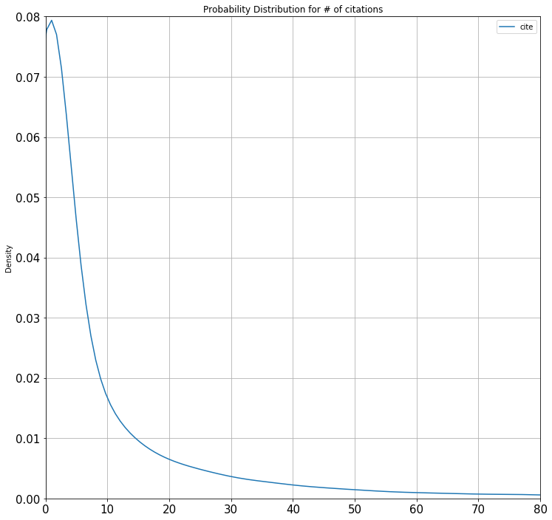
Citations
Understanding our target
Probability distribution of # of citations across all years.
x-axis: # of citations
y-axis: density
Most common: 0
Median: 2
Notes:
Mouna

Slide 13
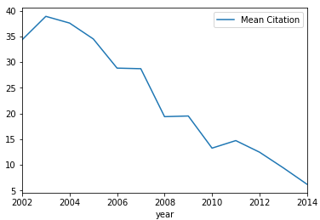
Relating Publication Year and Citations
Correlation between...
x-axis: publication year
y-axis: average # of citations
Notes:
Mouna

Slide 14
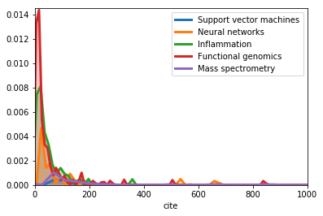
Relating Top 5 Keywords and Citations
Relating...
x-axis: # of citations
y-axis: area of distribution
Notes:
Steve

Slide 15
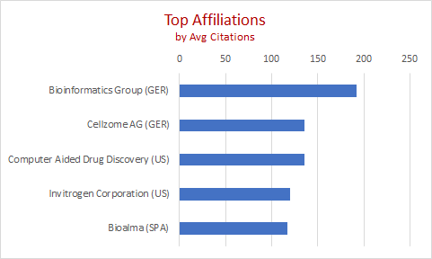
Relating Top 5 Affiliations and Citations
Notes:
steve

Slide 16
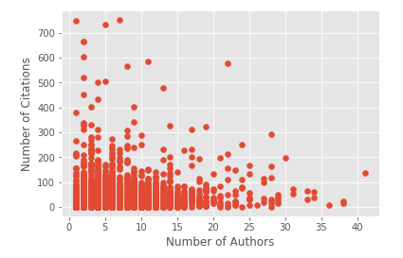
Relating Number of Authors and Citations
Relating...
x-axis: # of authors
y-axis: # of citations
Notes:
Logan

Slide 17
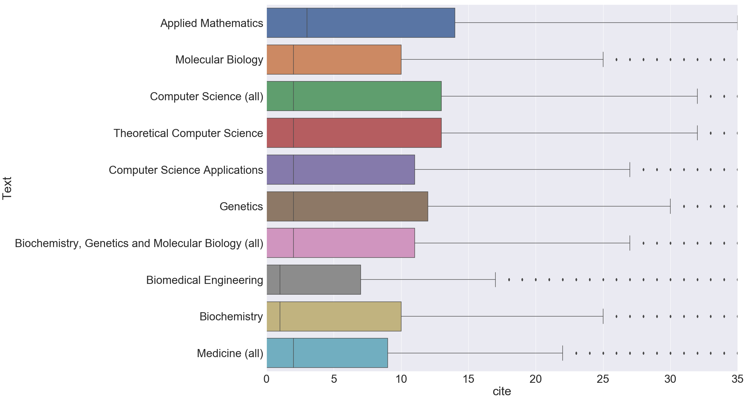
Relating Top 10 Fields and Citations
Relating...
x-axis: average citations
y-axis: top 10 most cited fields
Notes:
Logan

Slide 18
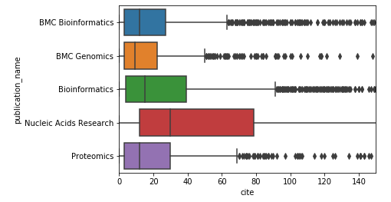
Top 5 Publication Venues
Notes:
Logan

Slide 19
Top 5 Authors and their Affiliations
 | Author Name | Mean Citations | Affiliations
1 | Christie K.R. | 305.75 | Stanford University, USA Stanford University School of Medicine, USA Jackson Laboratory, USA
2 | Hammond M. | 304.17 | European Bioinformatics Institute, UK Wellcome Trust, UK
3 | Morgat A. | 304.11 | Swiss Institute of Bioinformatics, Switzerland INRIA Rhone-Alpes, France, European Bioinformatics Institute, UK Universite de Geneve Faculte de Medecine, Switzerland Ecole Polytechnique Federale de Lausanne, Switzerland
4 | Barrett T. | 302.63 | National Library of Medicine, USA
5 | Barrell D.G. | 300.86 | Mississippi State University, USA European Bioinformatics Institute, UK European Molecular Biology Laboratory, UK Wellcome Trust Sanger Institute, UK
Notes:
Luke

Slide 20
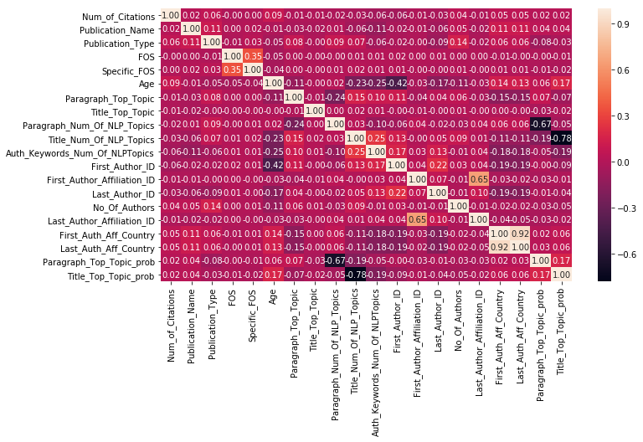
Correlation Heatmap: Num_of_Citations most important
Notes:
Luke

Slide 21
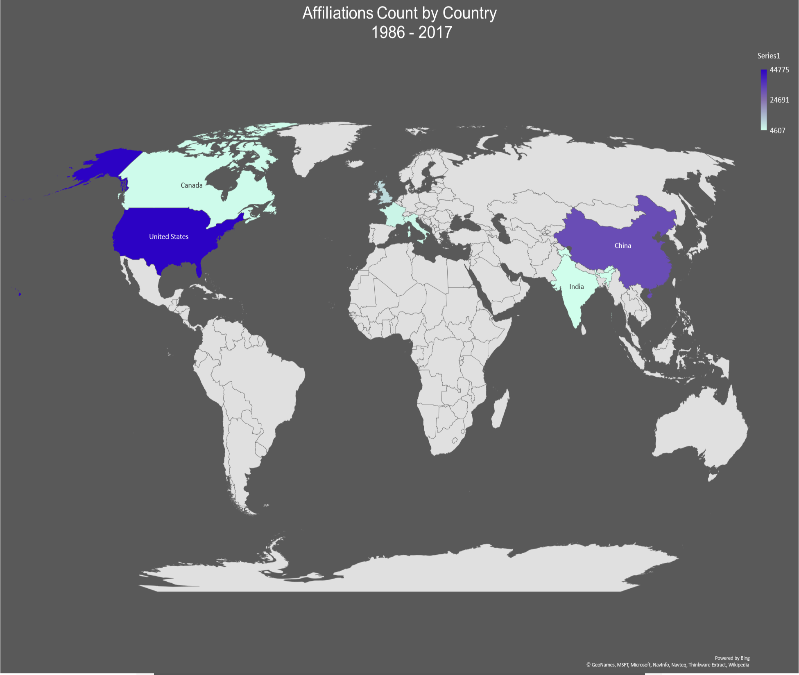
Notes:
Steve

Slide 22
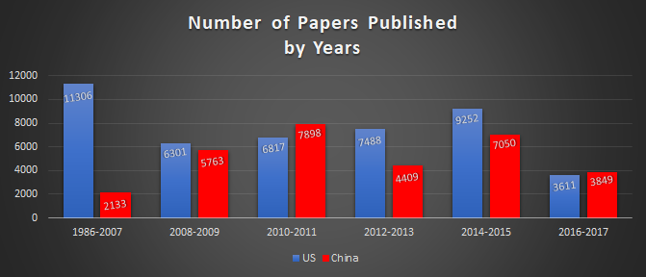
Papers Published by Top 2 Countries
Notes:
Steve

Slide 23
IV. Machine Learning
Preparing our data for Machine Learning
Applying Machine Learning
Notes:
Mouna

Slide 24
Preparing data for Machine Learning
Natural Language Processing:
Removing special characters
Removing stop words
Stemming
LDA(TFIDF)
Encoding
Notes:
Mouna

Slide 25
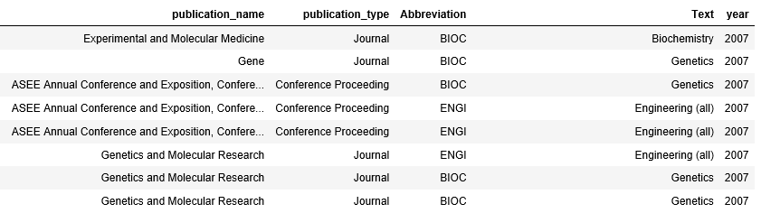
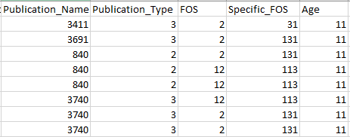
Encoding
Remaining textual columns were encoded.
Notes:
Mouna

Slide 26
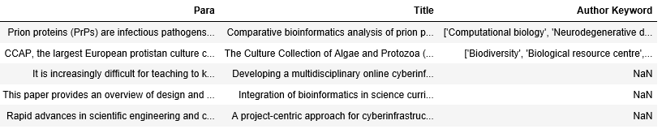
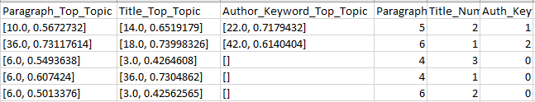
LDA models were created for the below columns(50 topics)
Topics with highest probabilities are chosen
Notes:
Mouna

Slide 27
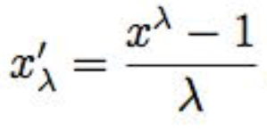
Data Transformation Techniques
Pandas qcut function
Box Cox Transformation
Log Transformation
Z Score
Notes:
Darpan

Slide 28
Machine Learning Algorithms
Random Forest Classification
XGB Classification
Notes:
Darpan

Slide 29
Random Forest Results
 | Test Accuracy | Precision | Recall | F1 Score
qcut | 0.6 | 0.6 | 0.6 | 0.59
Box Cox Transformation | 0.69 | 0.69 | 0.69 | 0.68
Log Transformation | 0.73 | 0.73 | 0.74 | 0.72
Notes:
Logan

Slide 30
XGB Results
 | Test Accuracy | Precision | Recall | F1 Score
qcut | 0.61 | 0.61 | 0.61 | 0.6
Box Cox Transformation | 0.7 | 0.7 | 0.71 | 0.69
Log Transformation | 0.74 | 0.73 | 0.74 | 0.72
Notes:
Logan

Slide 31
XGB with Log Transformation
 | precision | recall | F1 Score | support
Class 1 | 0.75 | 0.71 | 0.73 | 7597
Class 2 | 0.74 | 0.85 | 0.79 | 13055
Class 3 | 0.64 | 0.14 | 0.23 | 1985
avg / total | 0.73 | 0.74 | 0.72 | 22637
Notes:
Luke

Slide 32
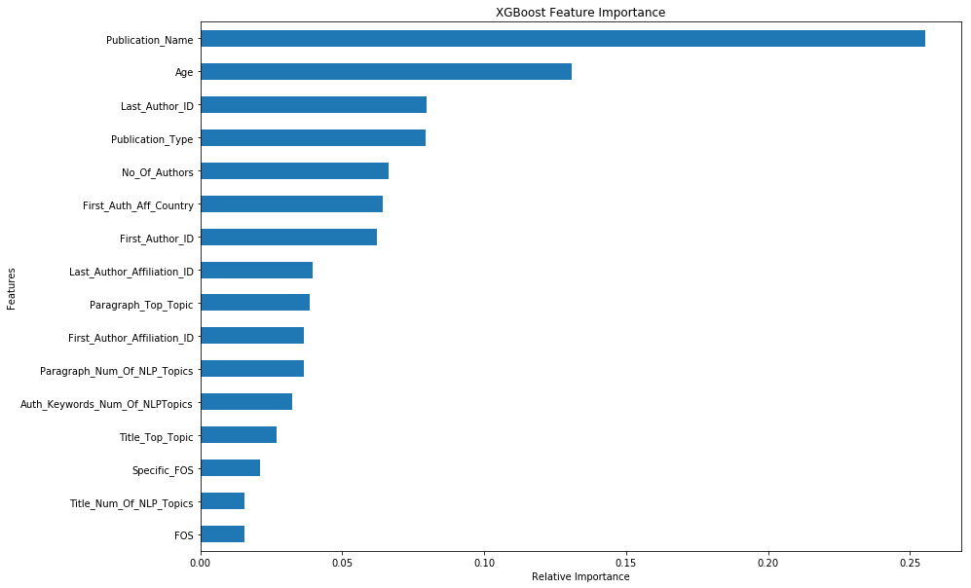
Feature Importance
Notes:
Luke

Slide 33

It has been an interesting journey.
THANK YOU!
https://github.com/UNCG-CSE/Bioinformatics_Trends
Visit us at...
Notes:
Luke

